Slide 1
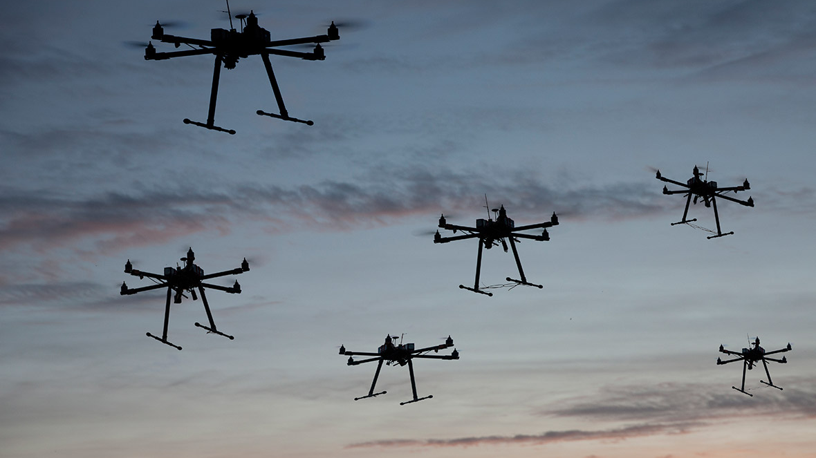
Ensuring UAS Airworthiness: Deep Learning-Based Powertrain Health Monitoring of UAVs
Prissha Chawla, Siddharth Urankar, Ally Blair [University of Cincinnati]
Chetan Kulkarni [KBR Inc, NASA Ames Research Center]
Manuel Arias Chao [Zurich University of Applied Sciences & TU Delft]
Manish Kumar [University of Cincinnati]

Slide 2

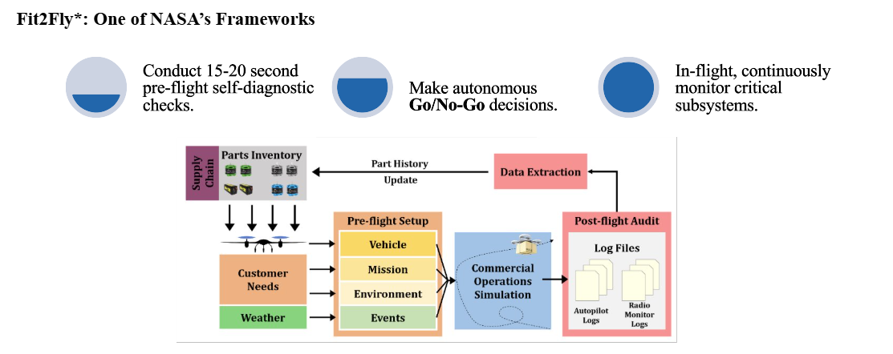
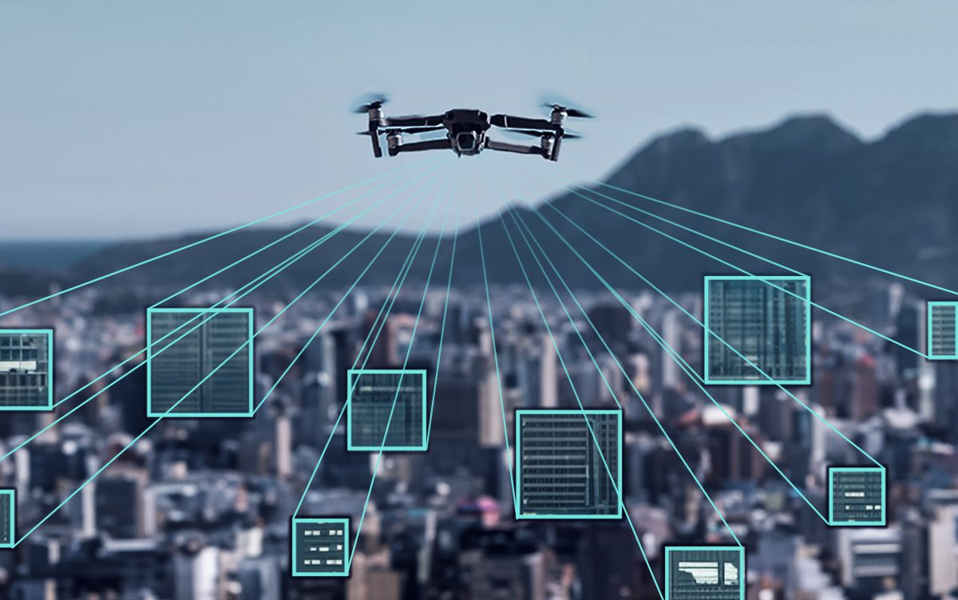
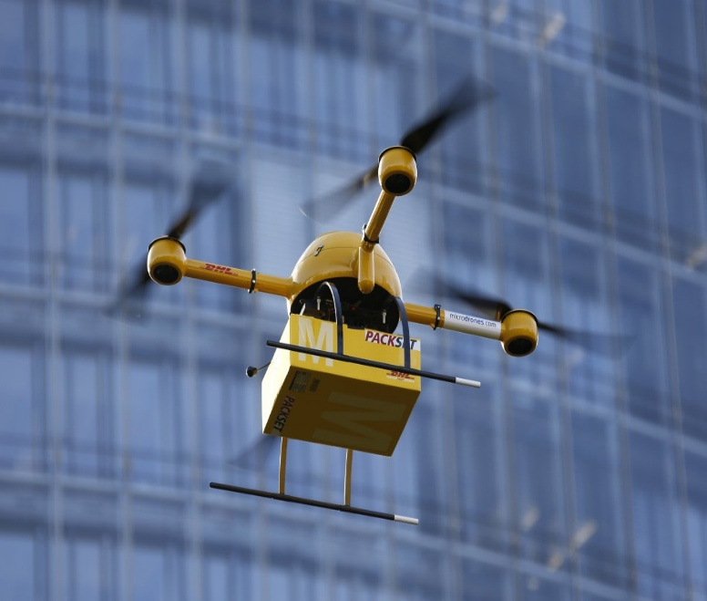
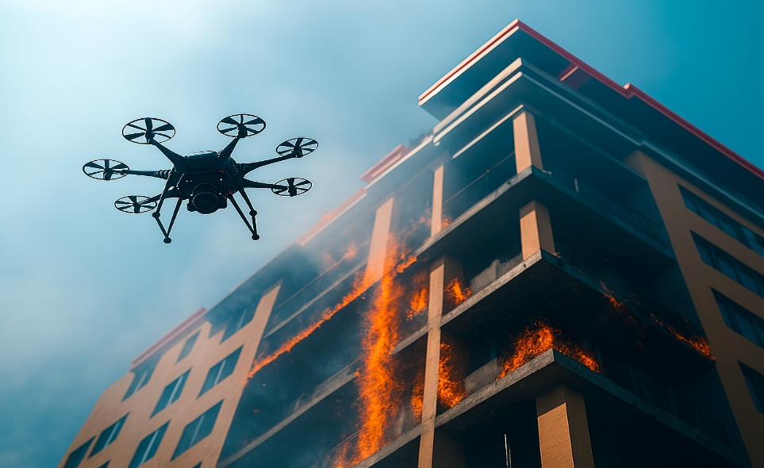
Introduction
Surveillance
Logistics
Fire Fighting
Search and Rescue
Hurricane / Disaster Relief
Ensuring reliability and operational readiness is essential for safe and efficient operations.

Slide 3
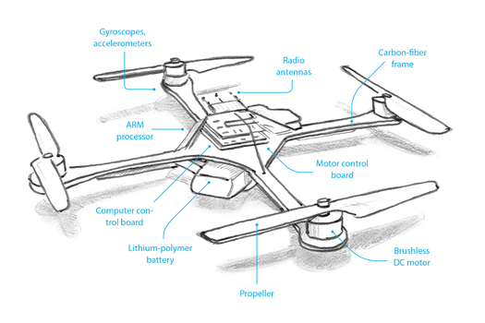
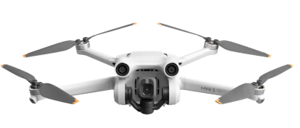

Vehicle Risk Factors
Vehicle Trust
Airworthiness Assessments
Major Risk Factors
Powertrain

Slide 4
Abstract
As Unmanned Aerial Vehicles (UAVs) become increasingly integral to logistics, surveillance, and emergency response, ensuring the reliability of their powertrain components, particularly motors and Li-ion batteries, is critical to safe and sustained operation. This work presents a comprehensive in-flight powertrain health monitoring framework that combines semi-supervised and supervised learning techniques to detect anomalies and predict degradation. Motor health is assessed using a semi-supervised one-dimensional Convolutional Neural Network (CNN) Autoencoder trained on healthy acoustic signatures of Brushless DC (BLDC) motors, enabling early fault detection without the need for large, labeled datasets. For battery health monitoring, a supervised Deep Operator Network (DeepONet) is trained on historical voltage and current data across multiple charge and discharge cycles to estimate battery degradation, predict Remaining Useful Life (RUL), and compute remaining flight time. The integration of both models enables real-time data-driven diagnostics of the UAV powertrain. This framework is designed for deployment within the In-time Aviation Safety Management System (IASMS), supporting both preflight readiness assessment and inflight anomaly detection, and improving UAV reliability in mission-critical environments.

Slide 5
User Stories
1. As a UAV operator, I want to automatically detect motor or propeller faults during flight to ensure safe landing and prevent crashes.
2. As a drone fleet manager, I want to track battery health and predict remaining flight time to plan missions more reliably.
3. As a remote operator, I want in-flight detection of propeller damage to avoid risky deployments.
4. As a UAV maintenance technician, I want pre-flight diagnostics to flag potential faults before operation.
5. As an aviation safety regulator, I want a standardized onboard health monitoring system to improve UAV safety and compliance.

Slide 6
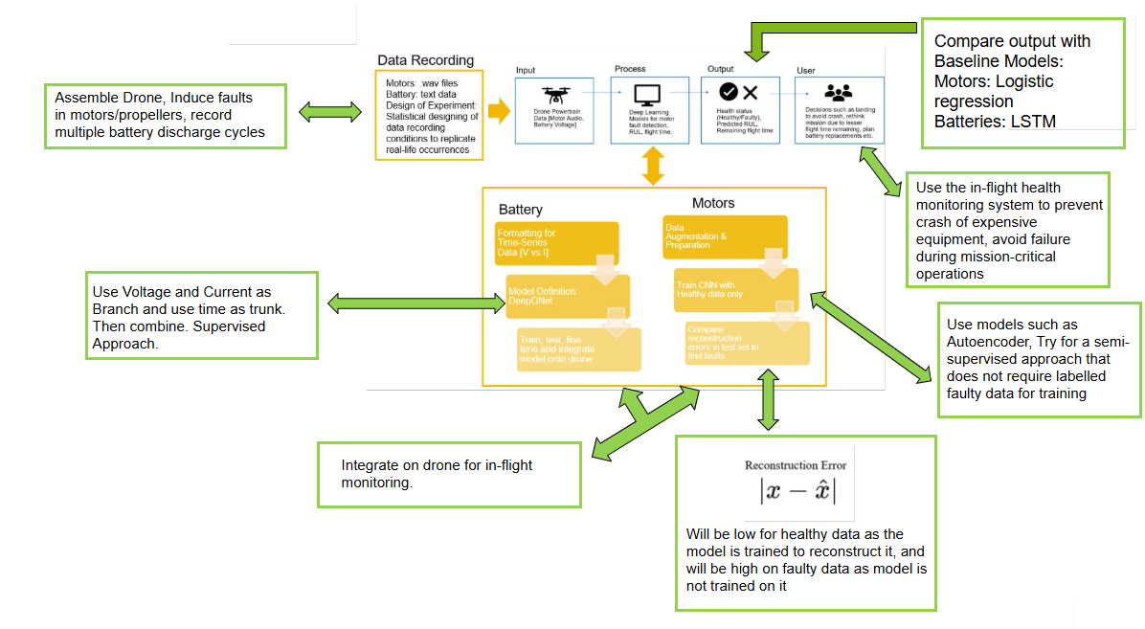

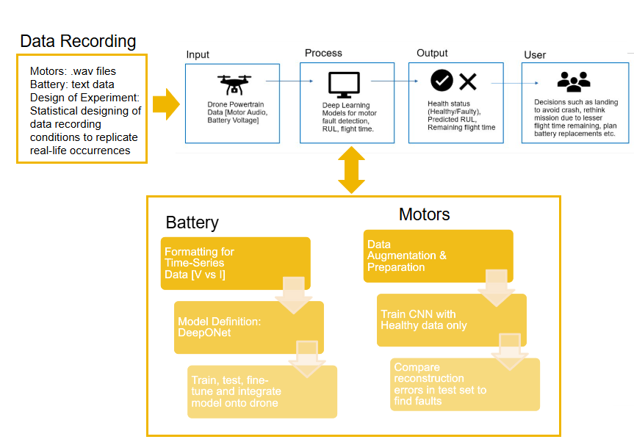
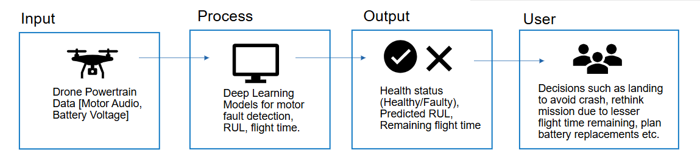
Design

Slide 7
Major Project Constraints
• Economic: Limited funding requires use of cost-effective sensors and open-source tools.
• Professional: Interdisciplinary collaboration between CS and ME students requires strict coordination.
• Ethical: Prioritize safety by minimizing false negatives — detecting potential faults even if data uncertainty is high.
• Legal: UAV testing must comply with institutional and FAA safety regulations.
• Environmental: Aim to reduce crash waste and promote sustainable drone operation.
• Data: Limited faulty data availability → use semi-supervised methods.

Slide 8
Review of Project Progress - Current state of project
Data recording for acoustics/motors
• Microphone selection and placement finalized
• Design of experiments completed
• Fault conditions induced under controlled setup
• Data organization and labeling completed
Modelling for fault detection
• Supervised and semi-supervised models trained and tested
• Misclassification analysis performed to identify discrepancies
• Fine-tuning in progress; current models performing reliably
Additional system development
• Second drone built and configured for battery data collection
• Temperature and current sensors ordered and under integration
• Jetson Nano successfully configured for real-time model inference and onboard data logging

Slide 9
Expected Accomplishments for the end of this term
By End of Fall 2025:
• Complete round 1 of battery data collection and pre-processing.
• Finalize DeepONet battery model architecture.
• Fully integrate motor fault detection model on Jetson for live inference.
• Conduct in-flight or stand-mounted system testing.
• Complete integration of second drone with temperature and current sensors.

Slide 10
Division of Work - Who is doing what on the project
Prissha Chawla – Data collection design, motor model development, fine-tuning, documentation.
Siddharth Urankar – Jetson integration, battery model development, onboard deployment, Expo presentation.
Ally Blair – Drone assembly, sensor integration, data recording, strain gauge setup.
Dr. Kumar & Luke – Faculty Advisor, University of Cincinnati.
Dr. Kulkarni (NASA) & Dr. Chao (ZHAW/TU Delft) – Research Mentors & Technical Review.

Slide 11
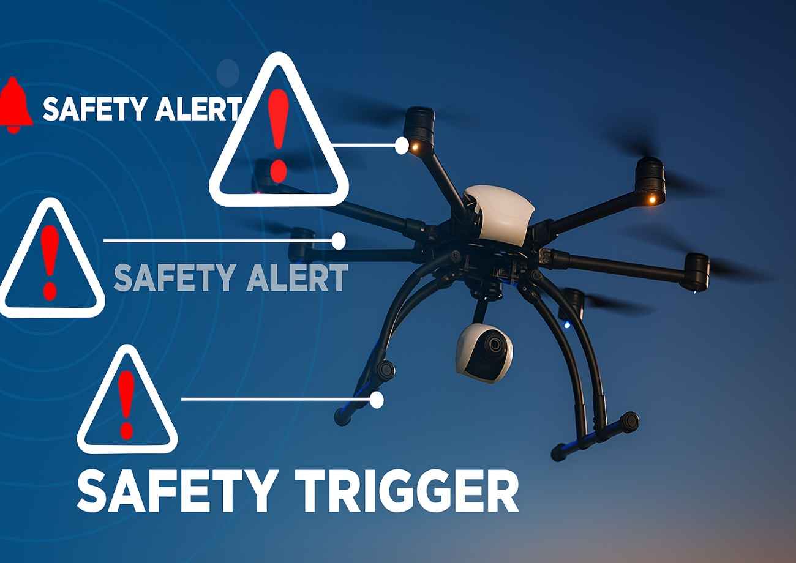
Expected Demo at Expo
• Drone mounted on stand, connected to Jetson Nano.
• Healthy motor → Model displays “Healthy.”
• Faulty motor swapped → Real-time anomaly detected (LED indicator).
• Dashboard displays motor health and battery RUL.
• Operator performs throttle changes to demonstrate detection robustness.
• Outcome: Demonstrates live in-flight fault monitoring aligned with NASA IASMS goals.

Slide 12
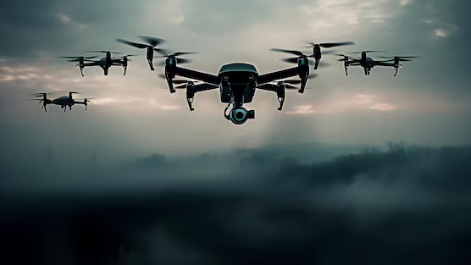
Thank You
Prissha Chawla, Siddharth Urankar, Ally Blair [University of Cincinnati]
Chetan Kulkarni [KBR Inc, NASA Ames Research Center]
Manuel Arias Chao [Zurich University of Applied Sciences & TU Delft]
Manish Kumar [University of Cincinnati]

